Slide 1


Top Discriminator Signal Over Bkg for several selection Categories NTUA
Giannis Papakrivopoulos
George Bakas

Slide 2
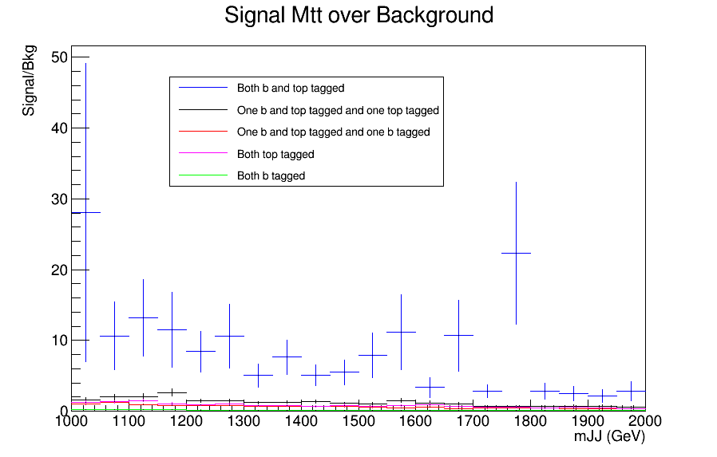
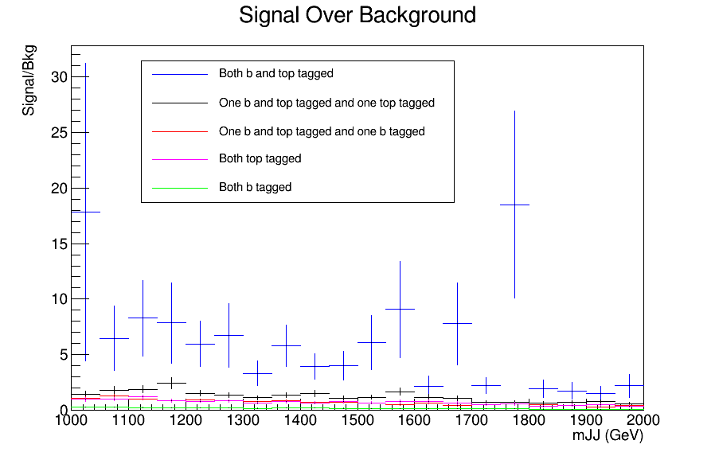
Signal over Bkg for mJJ (reco)
Top tagger cut : 0.6
B-tagging: loose working point
Cuts: nJets > 1, |jetEta| < 2.4 (bot jets), jetPt > 400 GeV (both jets)
120 GeV < jetMassSoftDrop < 200 GeV (both jets)
Signal Mtt Sample Over Bkg (All Categories)
nominal TT_TuneCUETP8M2T4_13TeV-powherg-pythia8
Over Bkg (All Categories)

Slide 3
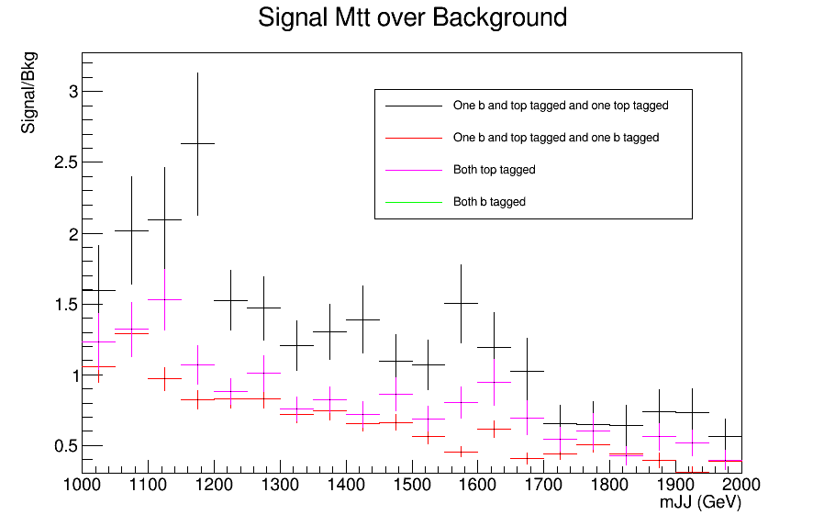
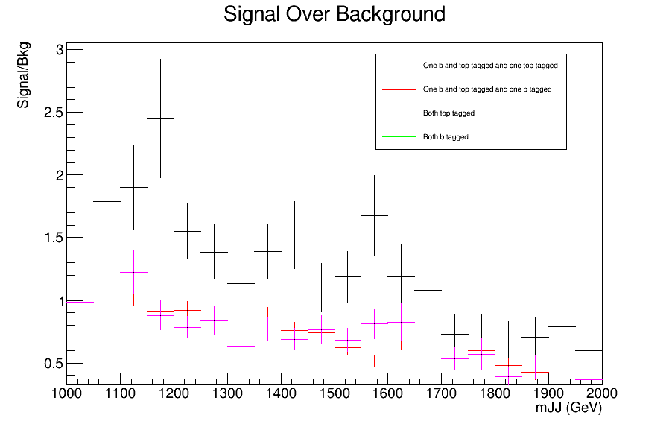
Signal over Bkg for mJJ (reco)
Top tagger cut : 0.6
B-tagging: loose working point
Cuts: nJets > 1, |jetEta| < 2.4 (bot jets), jetPt > 400 GeV (both jets)
120 GeV < jetMassSoftDrop < 200 GeV (both jets)
Signal Mtt Sample Over Bkg (Categories 2-5)
nominal TT_TuneCUETP8M2T4_13TeV-powherg-pythia8
Over Bkg (Categories 2-5)

